Slide 1
Representation learning in ECG classification
李安

Slide 2
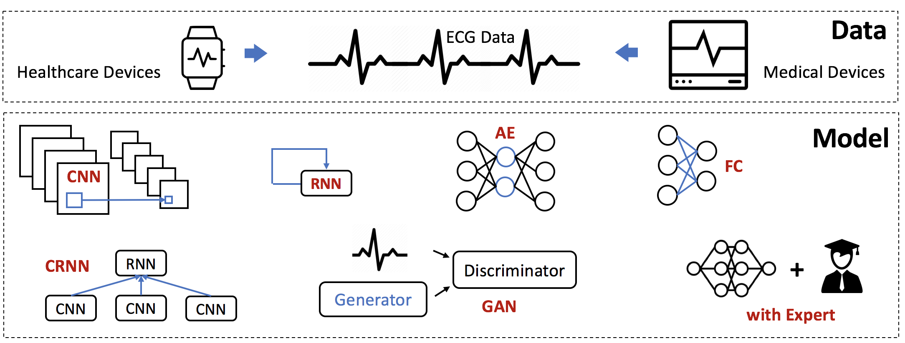
Opportunities and Challenges in Deep Learning Methods on Electrocardiogram Data: A Systematic Review

Slide 3
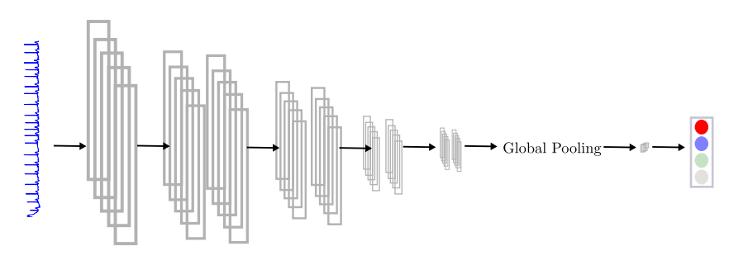
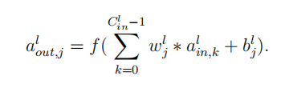
CNNs, LSTMs, and Attention Networksfor Pathology Detection in Medical Data

Slide 4
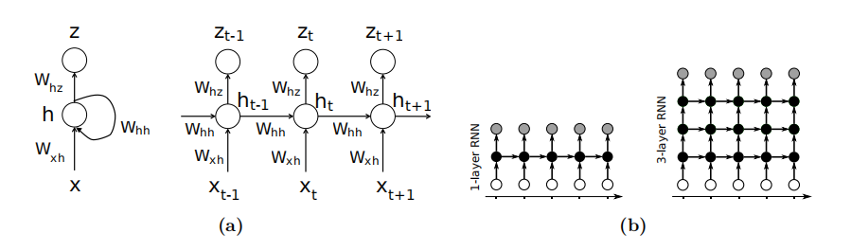
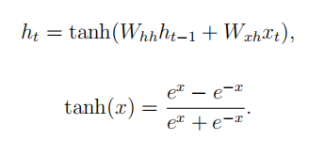

CNNs, LSTMs, and Attention Networksfor Pathology Detection in Medical Data

Slide 5
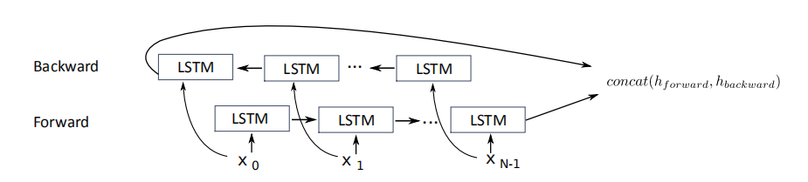
CNNs, LSTMs, and Attention Networksfor Pathology Detection in Medical Data

Slide 6
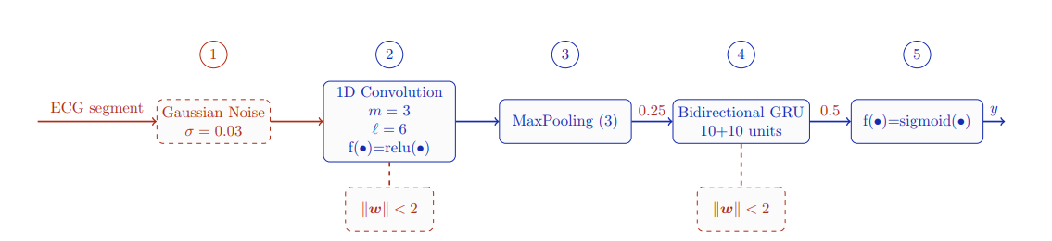

Deep Learning for Pulse Detection in Out-of-Hospital Cardiac Arrest Using the ECG

Slide 7
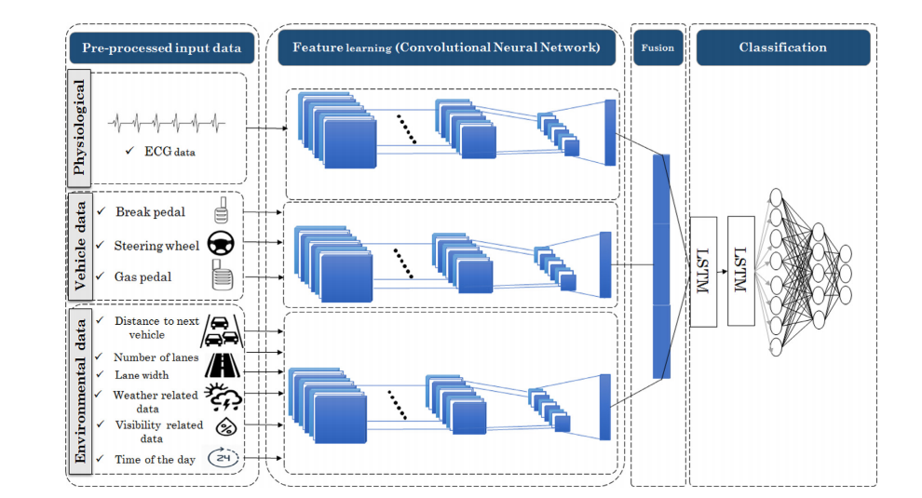
Automatic driver stress level classification using multimodal deep learning

Slide 8
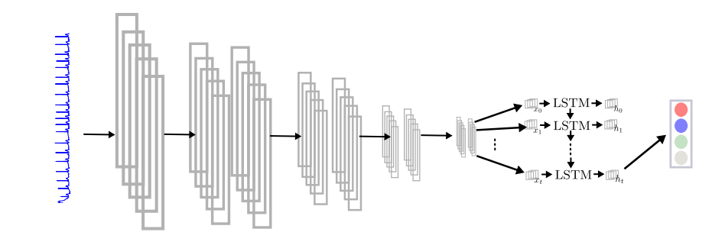
CNNs, LSTMs, and Attention Networksfor Pathology Detection in Medical Data

Slide 9
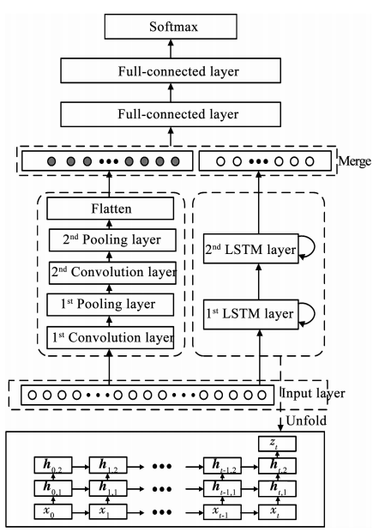
用于心律失常识别的LSTM和CNN并行组合模型

Slide 10
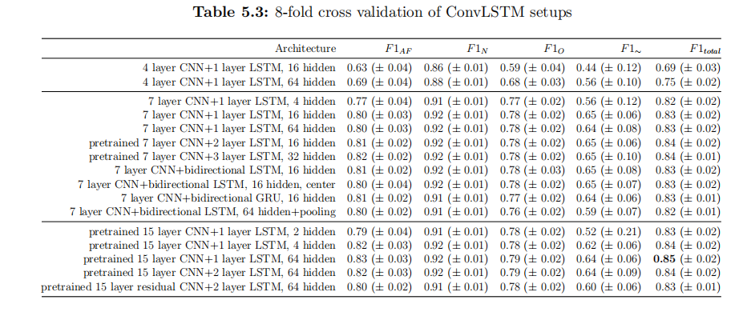
CNNs, LSTMs, and Attention Networksfor Pathology Detection in Medical Data

Slide 11
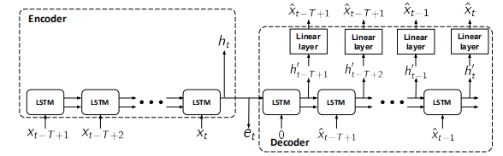

Improving Clinical Predictions through Unsupervised Time Series Representation Learning
Let f_{θ} and g_{φ} denote the encoder and decoder respectively, with parameters θ and φ

Slide 12
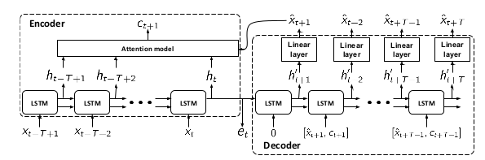
Improving Clinical Predictions through Unsupervised Time Series Representation Learning
Sequence-to-Sequence Forecaster with Attention (S2S-F-A)
F (h‘_{τ} , h_{j} ) = β^{T} tanh(W_{d} h'_{τ} + W_{e} h_{j} )

Slide 13
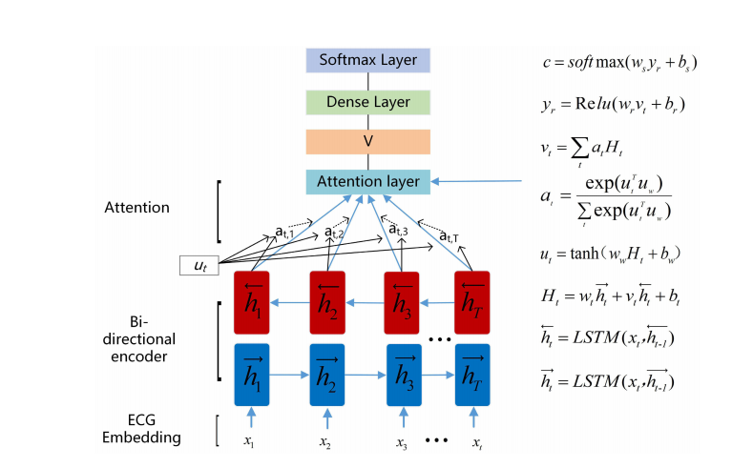
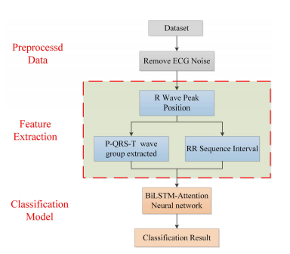
Interpretability Analysis of Heartbeat Classification Based on Heartbeat Activity's Global Sequence Features and BiLSTM-Attention Neural Network

Slide 14
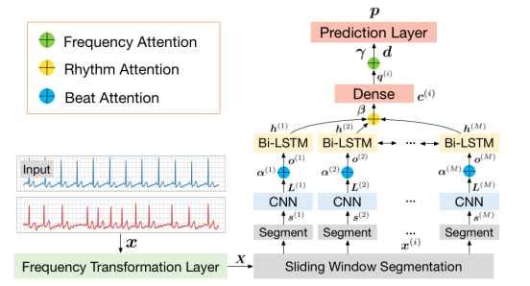
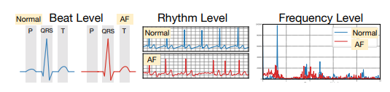
MINA: Multilevel Knowledge-Guided Attention for Modeling Electrocardiography Signals
通过分别提取多级（beat-, rhythm- and frequency-level）领域知识特征，MINA（MultIlevel kNowledge-guided Attention networks）通过多级注意力模型将医学知识和ECG数据结合在一起，从而使所学模型具有很高的解释性。

Slide 15
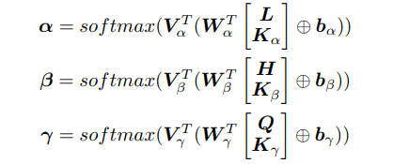
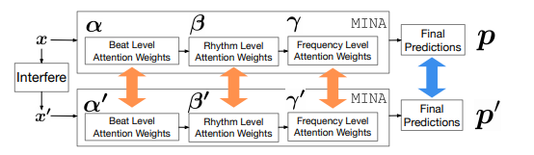
MINA: Multilevel Knowledge-Guided Attention for Modeling Electrocardiography Signals

Slide 16
THANK YOU

